Slide 1


Revolutionize finance: SPLITNEXUS APP
Transform finance with our Split Nexus App. Forget spreadsheets, effortlessly split expenses with loved ones. Simple, efficient, no Excel needed!. Multiple Mode Analysis

Slide 2
Presenter
Anmol Goyal
As the lead developer and project manager, Anmol played a pivotal role in building this app from the ground up.

Slide 3
Project Supervisor
Rabi .Panda
Associate Professor
Our dedicated supervisor who guided and mentored us throughout
the project.

Slide 4

Introduction
Our Split Nexus App is a game-changer in personal finance management. The app simplifies the process of splitting and tracking expenses with family and friends.
1
Effortless Splitting
2
Personal and Group Expenses
3
Smart Budgeting
The app allows users to easily split expenses and track who owes how much in real-time.
The app's analytics features provide clear insights into spending habits, helping users stay on top of their finances.
Users can create personal and group expenses, making it easy to manage shared expenses across multiple people.
4
Geo-Limit Enforcement
5
Voice Recognition
Geo-Limit Enforcement is a distinctive feature of our app, ensuring users stay within their budgetary boundaries by triggering alerts when expenses exceed predefined geographical limits. It's your financial safeguard on the go.
Voice Recognition, a cutting-edge technology at the heart of our app, enables users to effortlessly input expenses using voice commands, enhancing user convenience and minimizing manual data entry errors.

Slide 5
Technologies
Utilizing a powerful blend of HTML, CSS, JavaScript, PHP, and MySQL technologies, our web-based project offers a seamless and interactive financial management experience

Slide 6
Software Requirements
Web Browsers: Compatible with major web browsers like Chrome, Firefox, and Edge.
Operating System: Works on Windows, macOS, and Linux.
Development Tools: Uses standard coding tools, including text editors, Git for version control, and phpMyAdmin for database management.
Web Server: Hosted on servers like Apache or Nginx.
Server-Side Language: Powered by PHP.
Database: Utilizes MySQL for data storage.
Front-End: Implements HTML, CSS, and JavaScript (e.g., Bootstrap, jQuery) for the user interface.
Voice Recognition: Incorporates voice recognition libraries or APIs.
Web Hosting: Can be deployed on various hosting services like AWS or Heroku.
Communication: Uses standard web communication protocols (e.g., HTTP, WebSocket).

Slide 7
Client Devices
Personal Computers (PCs) and Laptops:
Operating System: Windows 10 or macOS 10.15 and above
RAM: Minimum 4GB RAM
Storage: Sufficient free storage for browser cache and local data storage
Mobile Devices (Smartphones and Tablets):
Operating System: Android 8.0 and above, iOS 12 and above
RAM: Minimum 2GB RAM
Storage: Adequate free storage for app installation and local data storage

Slide 8
Internet Connection
A stable and active internet connection is required for accessing the web-based Split Nexus App.

Slide 9
Server Infrastructure (for hosting the app)
Server Machines or Virtual Servers:
CPU: Dual-core or higher
RAM: Minimum 8GB RAM
Storage: As per application data and database requirements
Operating System Compatibility: Our Expense Sharing App is designed to be versatile and accessible. It supports multiple operating systems, including:
Windows 7 or later
macOS 10.15 (Catalina) or later
Linux distributions (e.g., Ubuntu 20.04 LTS)

Slide 10
Microphones (Optional)
If voice recognition is a preferred input method, users may need devices with built-in microphones or external microphones.

Slide 11
GPS (Optional)
For accurate location tracking and expense categorization, devices with GPS capabilities can enhance the user experience.

Slide 12
User Authentication and Registration
Allows users to create accounts, log in securely, and manage their profiles.

Slide 13
Voice Recognition
Enables voice-activated expense entry for a hands-free user experience.

Slide 14
Geo-Limit Enforcement
Sets geographical spending limits and monitors expenses within specified areas.

Slide 15
SPLIT EXPENSES SHARING
Shared the expense among multiple user or friends , relatives

Slide 16
Notifications
Sends alerts for limit exceedances and provides budget suggestions

Slide 17
User Profile Management
Allows users to customize their profiles and preferences.

Slide 18
Reports and Outputs
Generates reports and summaries of user expenses and financial trends.

Slide 19
Admin Panel
Provides administrative tools for managing user data and system settings

Slide 20
Expense Reports
Gain Insights: Our Expense Report feature offers valuable insights into your spending habits.
Informed Decisions: It empowers you to make informed financial decisions.
Simplified Tracking: Easily track and categorize your expenses for a clearer financial picture.
Budget Management: Set and manage budgets efficiently with detailed expense breakdowns.
Financial Advisor: Let the Expense Report guide you towards financial wellness.

Slide 21
Analytics
Data-Driven Insights: Analytics is the backbone of our Split Nexus App, offering data-driven insights into your financial activities.
Smart Decision-Making: It enables you to make smarter financial decisions based on real-time data.
Visualize Trends: Interactive charts and graphs help you visualize spending trends over time.
Predictive Analysis: Gain access to predictive analysis to anticipate future expenses and plan accordingly.
Empowering Users: Our analytics feature empowers users to take control of their finances with precision.

Slide 22
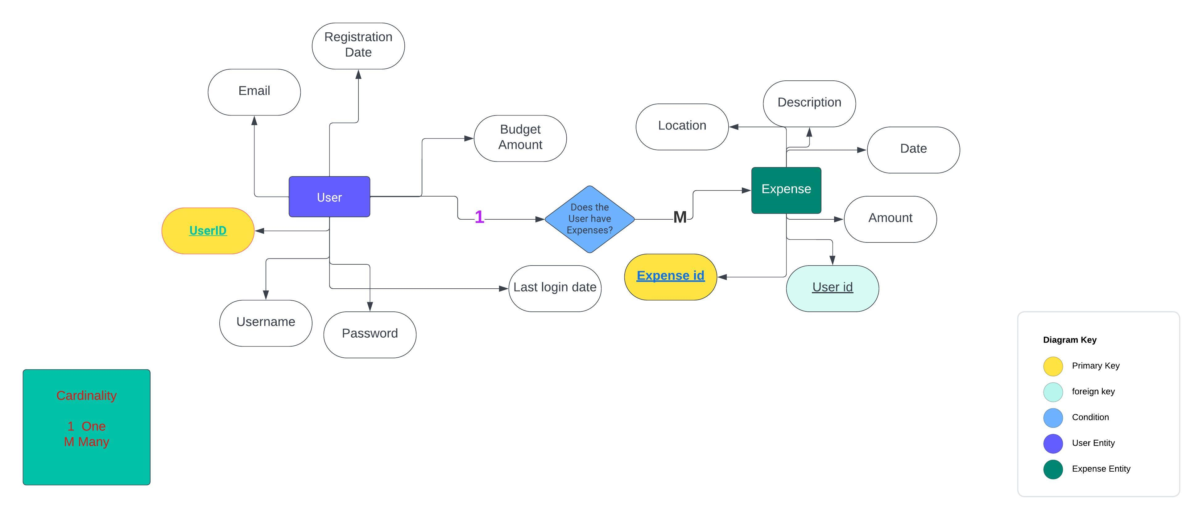
ENTITY RELATIONSHIP DIAGRAM
(APP OPENING PROCEDURE)

Slide 23
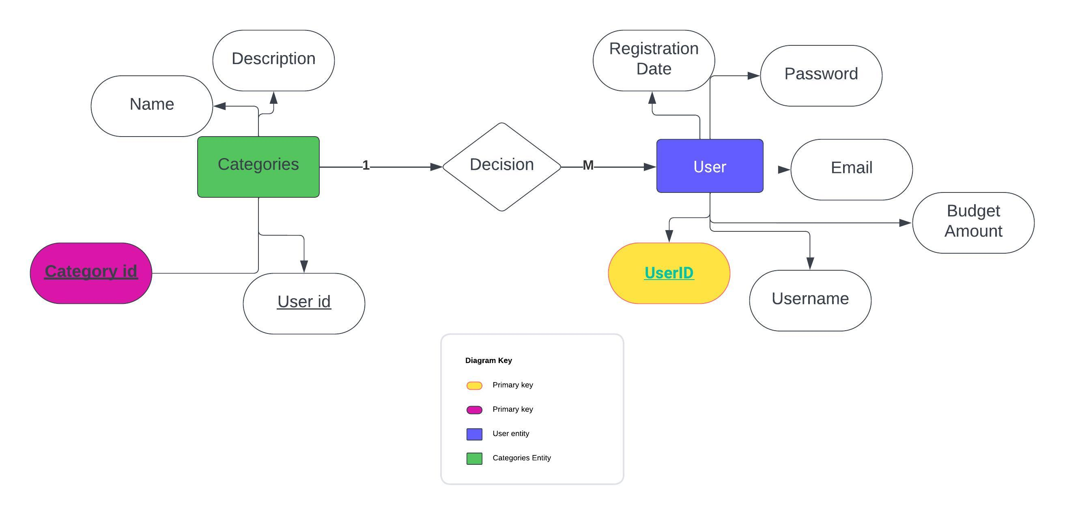
ENTITY RELATIONSHIP DIAGRAM
(Category Expense)

Slide 24
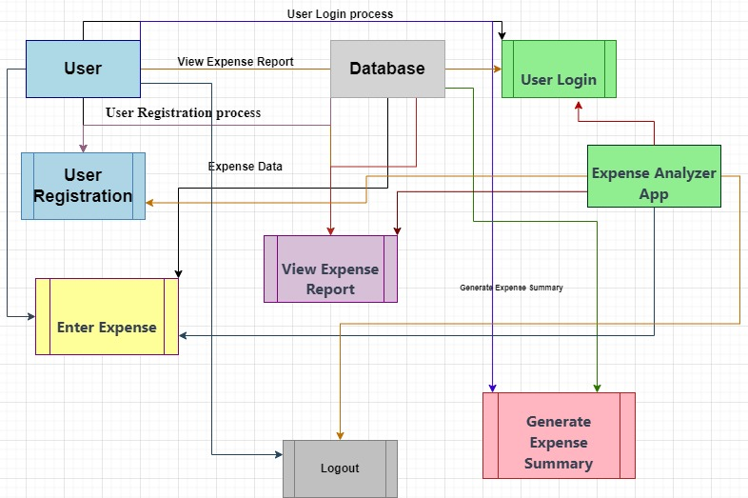
DATA FLOW DIAGRAM
(User Registration)

Slide 25
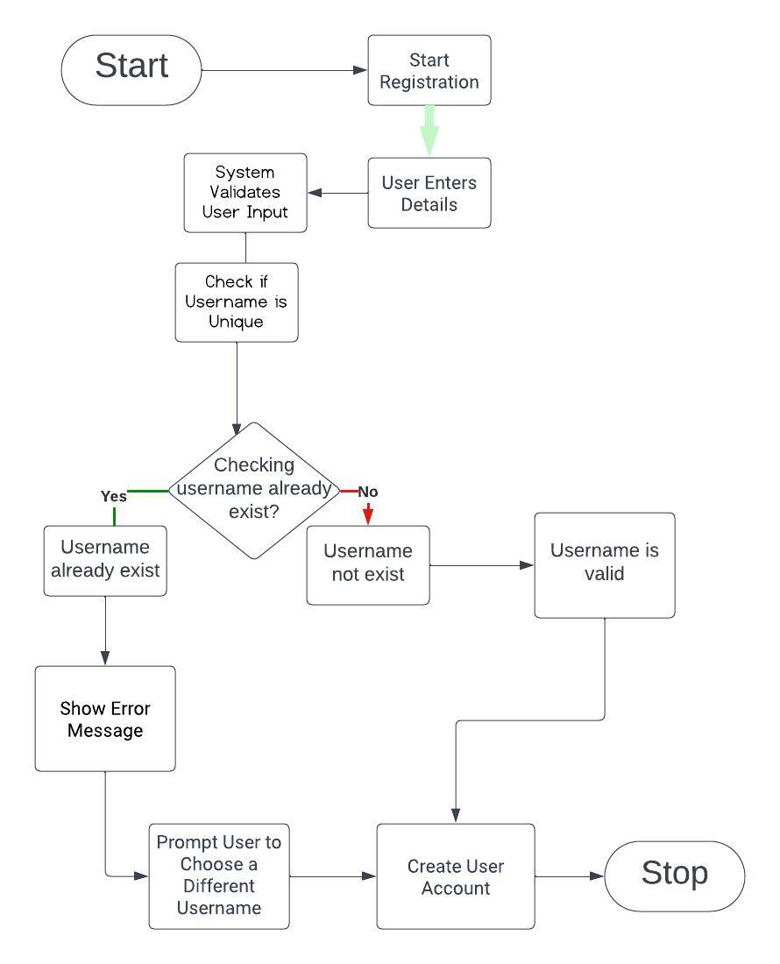
USE CASE DIAGRAM
(USERNAME IS VALID?)

Slide 26



How to Serve the Society
Financial Literacy
Responsible Spending
Accessibility
By simplifying expense tracking and budgeting, our app promotes financial literacy. Users become more aware of their spending habits and financial goals, leading to better financial decisions.
Our app is designed for cross-platform compatibility, making it accessible to a wide range of users. This inclusivity ensures that more people can benefit from improved financial management.
Geo-Limit Enforcement encourages responsible spending within specific areas. This feature can help individuals avoid overspending and contribute to a more financially responsible society.

Slide 27
Gantt Chart
Weeks
Tasks
Week 1
Project Initiation
Week 1 - Week 2
Requirements Gathering
Week 2 - Week 3
System Design
Week 2 - Week 3 - Week 4
Frontend Development
Week 3 - Week 4 - Week 5
Backend Development
Voice Recognition
Week 4 - Week 5 - Week 6
Testing and QA
User Testing
Week 5 - Week 6
Finalizing App
Week 6
Deployment
Project Review

Slide 28
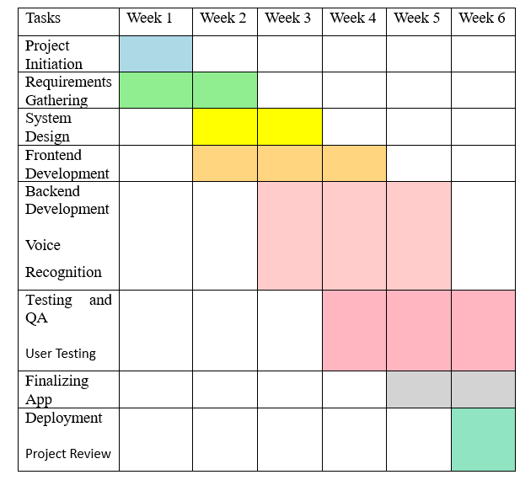
Gantt Chart

Slide 29
CONCLUSION
Developed user-friendly SplitNexus app
Utilized Bootstrap, Font Awesome, and JavaScript for a responsive interface.
Followed best practices in mobile app development and user-centric design.
Implemented version control through Git and GitHub for organized collaboration.
Enriched project with insights from "Effective Mobile App Development: Strategies and
Best Practices.“
Leveraged W3Schools' HTML Forms guide and JavaScript MDN Web Docs for user input
and dynamic content.
Optimized asset delivery with Content Delivery Networks (CDNs) for Bootstrap and Font
Awesome.
Resulted in a robust solution for collaborative financial management.

Slide 30
Thank You!
Split Nexus: Redefining Shared Finances

